Slide 1
Create chatbot using python

Slide 2

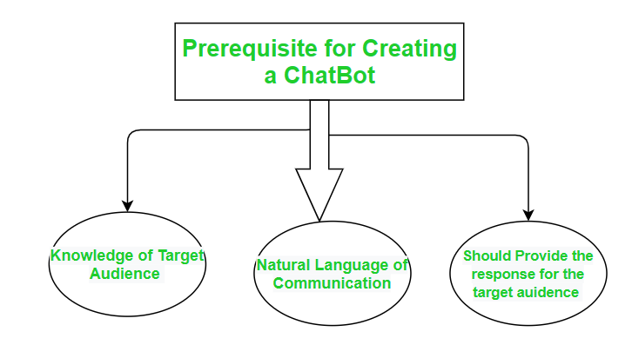



A ChatBot is basically a computer program that conducts conversation between a user and a computer through auditory or textual methods. It works as a real-world conversational partner.

Slide 3
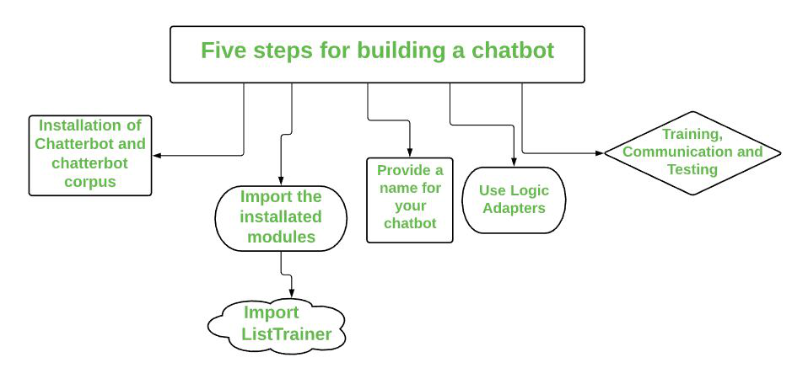
ChatterBot is a library in python which generates a response to user input. It used a number of machine learning algorithms to generates a variety of responses. It makes it easier for the user to make a chatbot using the chatterbot library for more accurate responses. The design of the chatbot is such that it allows the bot to interact in many languages which include Spanish, German, English, and a lot of regional languages. The Machine Learning Algorithms also make it easier for the bot to improve on its own with the user input. How To Make a Chatbot in five steps using Python? We’ll take a step-by-step approach and eventually make our own chatbot.

Slide 4

Let’s begin the journey of our own chatbot in the shortest way possible:-
Step 1. Install the Chatterbot and chatterbot_corpus module :
The first and foremost step is to install the chatterbot library. You also need to install the chatterbot_corpus library. Basically, Corpus means a bunch of words. The Chatterbot corpus contains a bunch of data that is included in the chatterbot module. The corpus is used by bots to train themselves.
Run the following pip commands on the terminal for installation:
pip install chatterbot pip install chatterbot_corpus
Step 2. Import the modules
we have to import two classes: ChatBot from chatterbot and ListTrainer from chatterbot.trainers.
ListTrainer: Allows a chatbot to be trained using a list of strings where the list represents a conversation.
from chatterbot import ChatBot
from chatterbot.trainers import ListTrainer
Step 3. Name our Chatbot:
Now, we will give any name to the chatbot of our choice. Just create a Chatbot object. Here the chatbot is maned as “Bot” just to make it understandable.
bot = ChatBot('Bot')

Slide 5

Step 4: Use of Logic Adapter: The Logical Adapter regulates the logic behind the chatterbot that is, it picks responses for any input provided to it. This parameter contains a list of all the logical operators. When more than one logical adapter is put to use, the chatbot will calculate the confidence level, and the response with the highest calculated confidence will be returned as output. Here we have used two logical adapters: BestMatch: The BestMatchAdapter helps it to choose the best match from the list of responses already provided. TimeLogicAdapter: The TimeLogicAdapter identifies statements in which a question about the current time is asked. If a matching question is detected, then a response containing the current time is returned. chatbot = ChatBot( 'JARVIS', logic_adapters=[ 'chatterbot.logic.BestMatch', 'chatterbot.logic.TimeLogicAdapter'], )

Slide 6
Step 5: Training, Communication, and Testing : For the training process, you will need to pass in a list of statements where the order of each statement is based on its placement in a given conversation. We have to train the bot to improve its performance for this we need to call the train() method by passing a list of sentences. Training ensures that the bot has enough knowledge to get started with specific responses to specific inputs. After training, let’s check its communication skills. And the last step is to do testing You have to execute the following commands now: from chatterbot.trainers import ListTrainer trainer = ListTrainer(bot) trainer.train([ 'Hi', 'Hello', 'I need roadmap for Competitive Programming', 'Just create an account on GFG and start', 'I have a query.', 'Please elaborate, your concern', 'How long it will take to become expert in Coding ?', 'It usually depends on the amount of practice.', 'Ok Thanks', 'No Problem! Have a Good Day!' ])

Slide 7
Now let, test the chatbot: response = bot.get_response("Good morning!") print(response) Output: HELLO Below is the full implementation: from chatterbot import ChatBot from chatterbot.trainers import ListTrainer from chatterbot.trainers import ListTrainer bot = ChatBot('Bot') trainer = ListTrainer(bot) trainer.train([ 'Hi', 'Hello', 'I need roadmap for Competitive Programming', 'Just create an account on GFG and start', 'I have a query.', 'Please elaborate, your concern', 'How long it will take to become expert in Coding ?', 'It usually depends on the amount of practice.', 'Ok Thanks', 'No Problem! Have a Good Day!' ]) while True: request=input('you :') if request == 'OK' or request == 'ok': print('Bot: bye') break else: response=bot.get_response(request) print('Bot:', response)

Slide 8
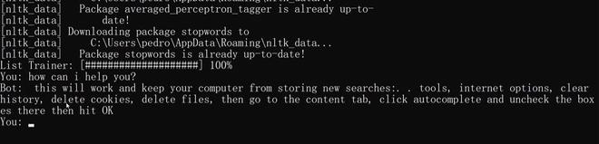
Output:

Slide 9
THE END

